Slide 1
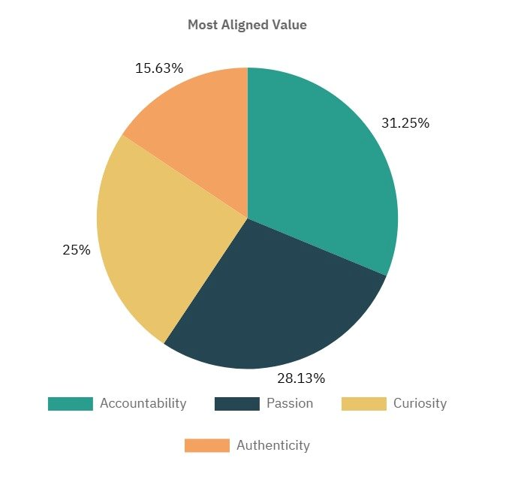
Which is values that u feel you are most aligned with?

Slide 2
DEMO

Slide 3
DEMO

Slide 4
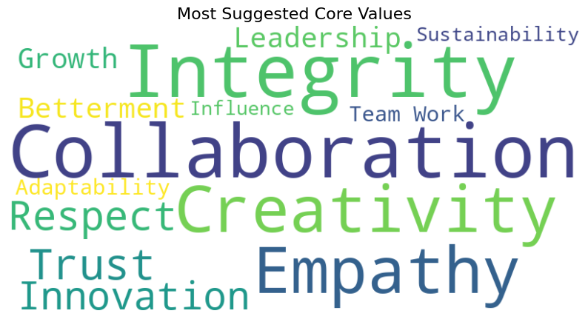
Which is the fifth value that you would like to add?

